Slide 1

Vel Tech Rangarajan Dr. Sagunthala R&D Institute of Science and Technology
School of Computing
Department of Computer Science and Engineering
10211CS224 / FULL STACK APPLICATION DEVELOPMENT (JAVA)
PROJECT REVIEW : MILESTONE PROJECT – 1
Date: 04-03-2026
Dynamic Online Examination & Result Processing System
SDG 4 – Quality Education
Presented By:
A.PRANEETHA– VTU24447 –23UECS0052
Courses Handling Faculty:
Dr. S . Hemamalini,M.E,Ph.D.,
Assistant Professor (senior grade)

Slide 2
INTRODUCTION
1
Background:
Traditional examination systems rely heavily on manual processes for conducting tests and evaluating answer sheets.
Need for the Project:
Manual evaluation consumes time and may lead to calculation errors or delays in result publishing.
There is a need for a reliable system that ensures faster assessment and immediate result generation.
Real-World Relevance:
With the rise of digital education platforms, institutions require automated and efficient assessment systems.
System Overview:
The proposed Dynamic Online Examination & Result Processing System enables students to attend exams online and receive instant results through automated evaluation.
2
3
4
5
6
7
8
9

Slide 3
PROBLEM STATEMENT
1
Despite the rapid digital transformation in education, many institutions still rely on traditional examination methods that involve manual paper evaluation. This process is time-intensive, increases faculty workload, and often leads to delays in result publication. Moreover, manual correction lacks transparency and may introduce human errors in scoring.
As academic systems evolve towards digital platforms, there is a pressing need for an efficient, automated, and reliable examination framework. Institutions require a solution that can conduct assessments seamlessly, evaluate responses instantly, and maintain accuracy and consistency in result generation.
Hence, a dynamic online examination and result processing system becomes essential to modernize assessment practices and enhance overall academic efficiency.
2
3
4
5
6
7
8
9

Slide 4
OBJECTIVE(S)
1
To design and develop a dynamic online examination system that enables secure and structured assessment.
Automate the evaluation process for objective-type questions and generate instant results.
Reduce manual workload and eliminate errors in score calculation.
Provide a user-friendly interface for both administrators and students.
Ensure accuracy, transparency, and efficiency in the examination process.
2
3
4
5
6
7
8
9

Slide 5
PROPOSED SYSTEM
1
After analysing the limitations of traditional examination methods, a web-based Dynamic Online Examination and Result Processing System was designed to automate the assessment process.
The system was developed using a structured full-stack approach, integrating frontend interfaces with backend logic for seamless functionality.
An administrator module was implemented to add, manage, and organize question banks dynamically.
A secure login mechanism was incorporated to ensure controlled access for users.
The examination module was designed to allow students to attempt objective-type questions in an interactive and user-friendly environment.
Automatic evaluation logic was implemented to calculate scores instantly upon submission.
The result processing component generates and displays performance instantly, enhancing transparency and eliminating delays.
Overall, the system provides a reliable, efficient, and scalable digital solution for modern academic assessment.
2
3
4
5
6
7
8
9

Slide 6
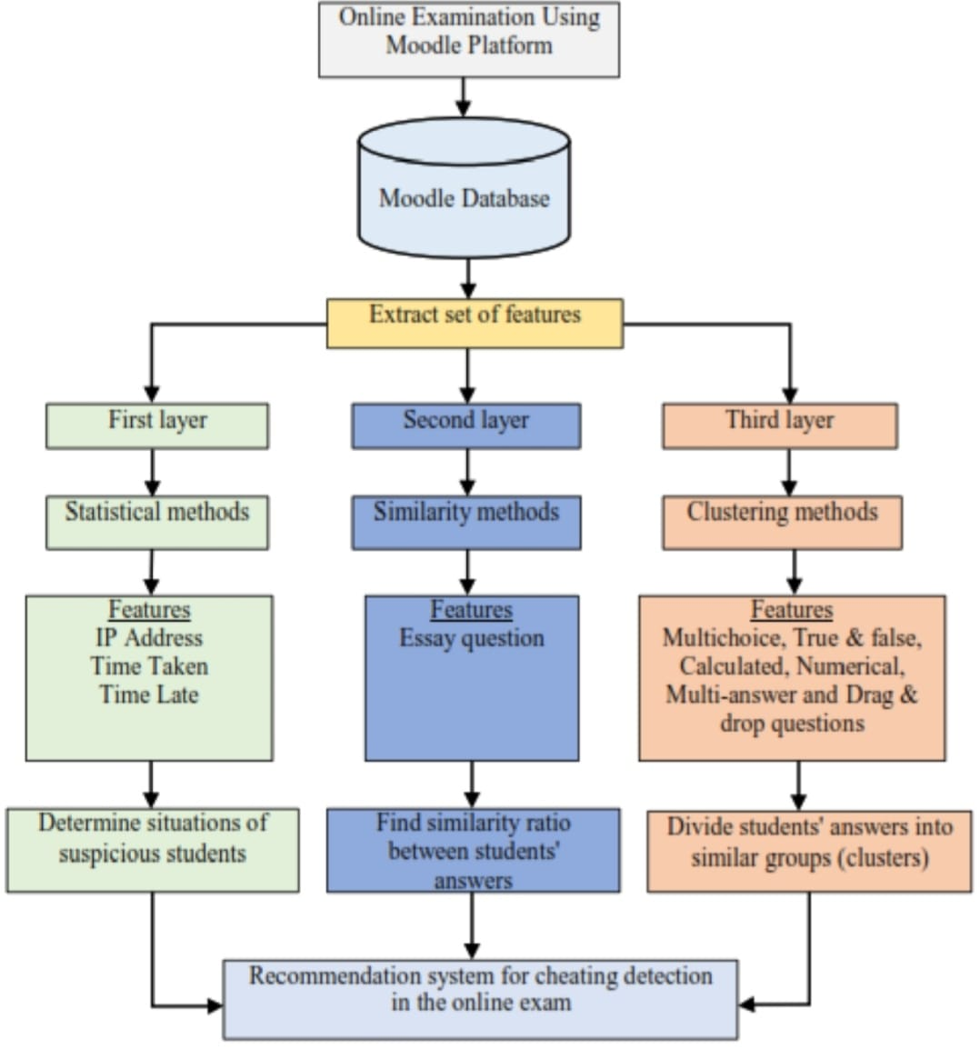
PROPOSED SYSTEM ARCHITECTURE
Input :
The system receives input from both admin and students.
Admin enters questions and correct answers into the system.
Students log in and submit their responses during the exam.
Processing :
The Flask backend handles authentication and exam flow.
It checks student answers with stored correct answers.
The system calculates the score instantly after submission.
Database :
Question details and answers are stored in structured lists within the application.
User session data is maintained during the exam.
The system manages exam and result data through backend logic.
Output :
The system generates results immediately after exam submission.
Students can view their scores instantly on the result page.
This ensures quick, accurate, and transparent evaluation.
1
2
3
4
5
6
7
8
9

Slide 7
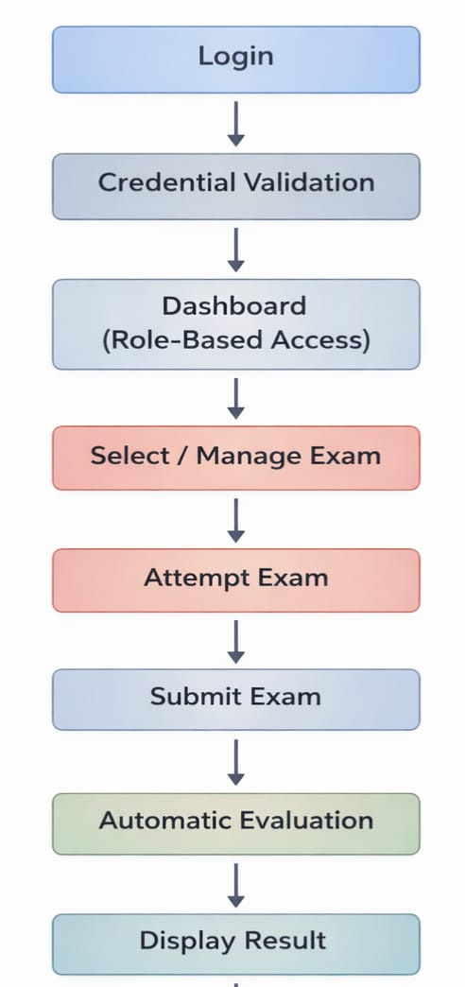
WORKFLOW
1
2
3
4
5
6
7
8
9

Slide 8
TECHNOLOGIES USED
Frontend :
The frontend was developed using HTML and CSS to design responsive and user-friendly web pages.
Enhanced styling was added to improve layout, alignment, colors , and overall user experience.
It provides interfaces for login, dashboard, exam attempt, and result display.
Backend :
The backend was implemented using Python with the Flask framework.
It handles authentication, exam processing, answer validation, and result calculation.
Database :
Currently, data is maintained using structured lists within the application code.
Question details, correct answers, and user session data are managed through backend logic.
Tools :
The system was developed using Visual Studio Code as the code editor.
Testing and execution were performed using a local development server and web browser.
Hardware / Software Requirements :
Hardware : A standard computer or laptop with minimum 4GB RAM.
Software : Python, Flask library, and a web browser for execution.
1
2
3
4
5
6
7
8
9

Slide 9
MODULE DESCRIPTION
Module 1: User Authentication Module
The User Authentication module is responsible for handling the login functionality of the system. It verifies user credentials and ensures that only authorized users can access the examination portal. This module also maintains user session data during the exam process.
Module 2: Question Management Module
The Question Management module manages the storage and organization of exam questions and correct answers. In the current implementation, questions are maintained using structured lists within the application code. This module ensures that the correct set of questions is displayed during the examination.
Module 3: Examination Module
The Examination module allows students to attempt objective-type questions through a user-friendly interface. It manages the flow of the exam, records the selected answers, and handles the submission process smoothly.
Module 4: Evaluation and Result Module
The Evaluation and Result module processes the submitted answers by comparing them with the stored correct answers. It automatically calculates the score and generates the result instantly. The final output is displayed clearly to the student, ensuring accuracy and transparency.
1
2
3
4
5
6
7
8
9

Slide 10
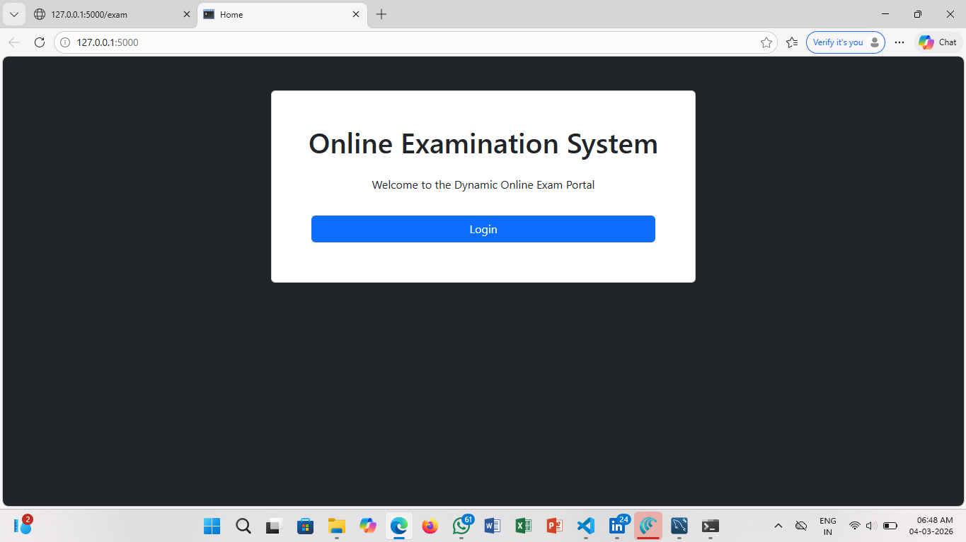
IMPLEMENTATION SCREENSHOTS
1
Home page :
The Home Page gives a clear introduction to the online examination system . It provides navigation options for students and administrators . The design is simple, user-friendly, and easy to access.
2
3
4
5
6
7
8
9

Slide 11
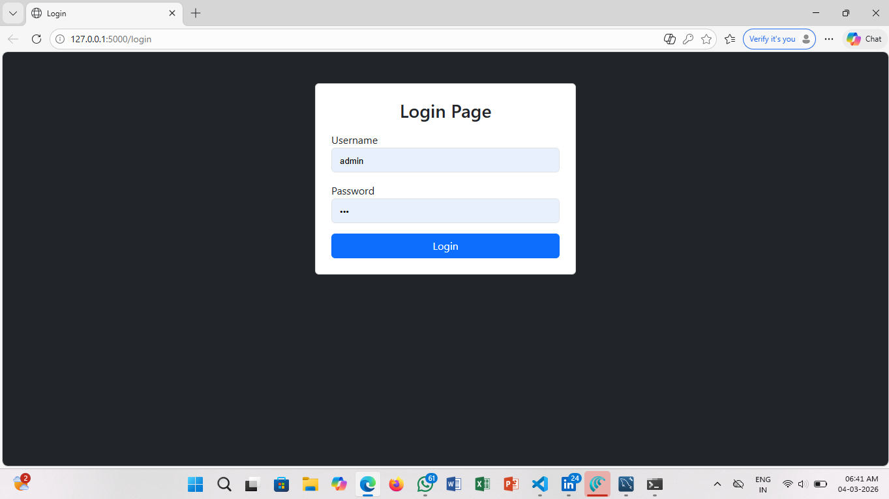
IMPLEMENTATION SCREENSHOTS
Login Page :
The Login Page allows users to securely enter their credentials . It verifies user details and redirects them to their respective dashboard . Recent updates improved validation and smooth login functionality.
1
2
3
4
5
6
7
8(A)
9

Slide 12
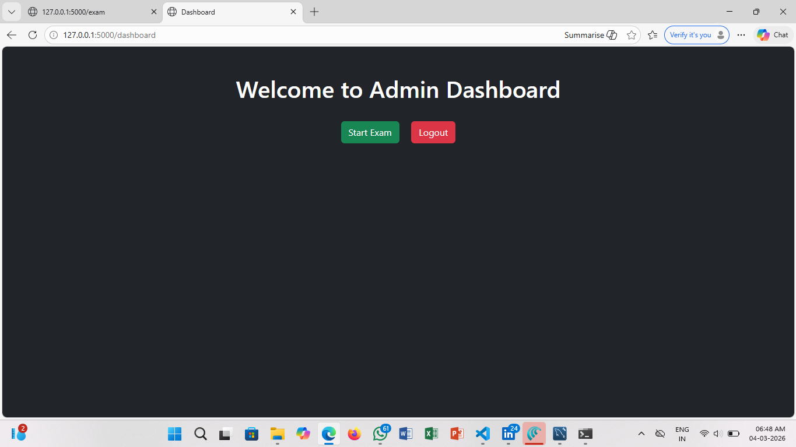
IMPLEMENTATION SCREENSHOTS
Dashboard page :
The Dashboard displays important options like exams, results, and management features . Students can attend exams, while admins can manage questions and records . The updated layout makes navigation more organized and efficient.
1
2
3
4
5
6
7
8(B)
9

Slide 13
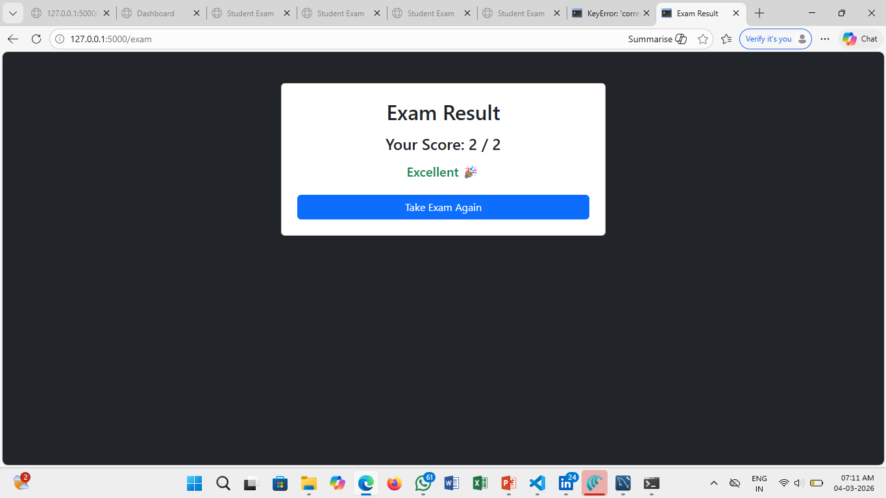
IMPLEMENTATION SCREENSHOTS
Result page :
The Result Page shows the student’s exam performance and score instantly . It calculates results accurately based on submitted answers . Recent changes ensure faster result processing and better clarity.
1
2
3
4
5
6
7
8(C)
9

Slide 14
ADVANTAGES & LIMITATIONS
1
Advantages :
Instant Result Generation
Reduced Manual Effort
User-Friendly Interface
Improved Accuracy
Lightweight and Easy Deployment
Limitations :
No External Database Integration
Basic User Interface Design
Limited Security Features
Supports Only Objective-Type Questions
Local Deployment Only
2
3
4
5
6
7
8
9

Slide 15
Thank you

